Slide 1
VPC Creation

Slide 2
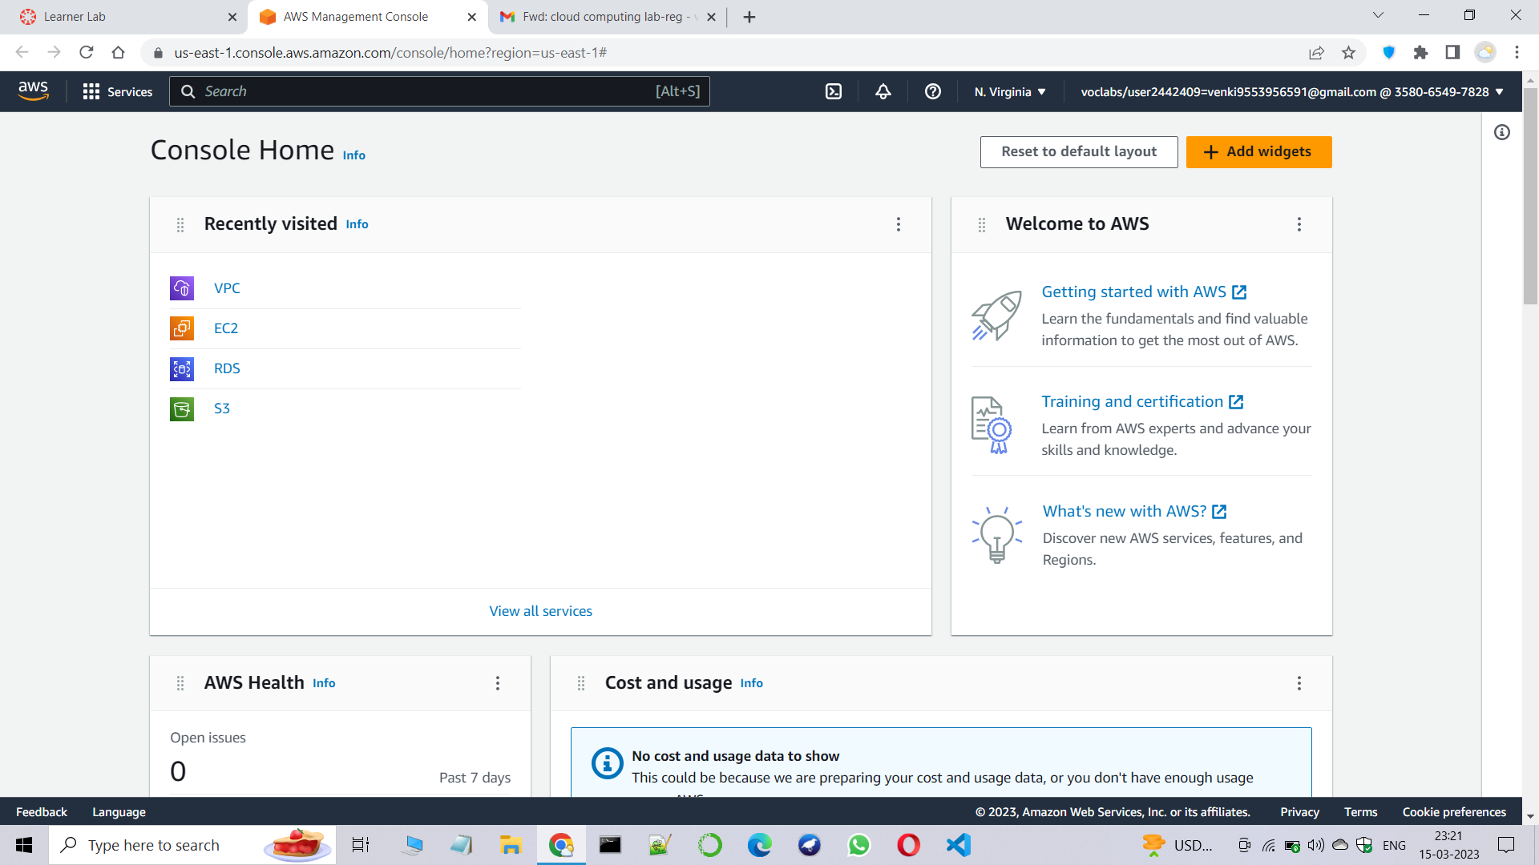
Step1:Goto the AWS console and search for VPC

Slide 3
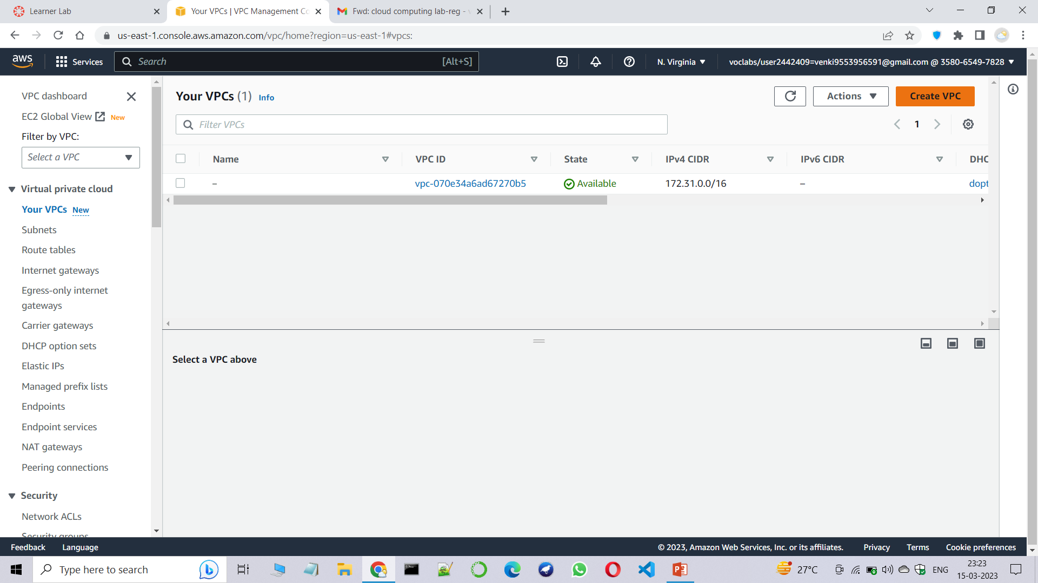
Step2:Click on your VPCs and click on create VPC.

Slide 4
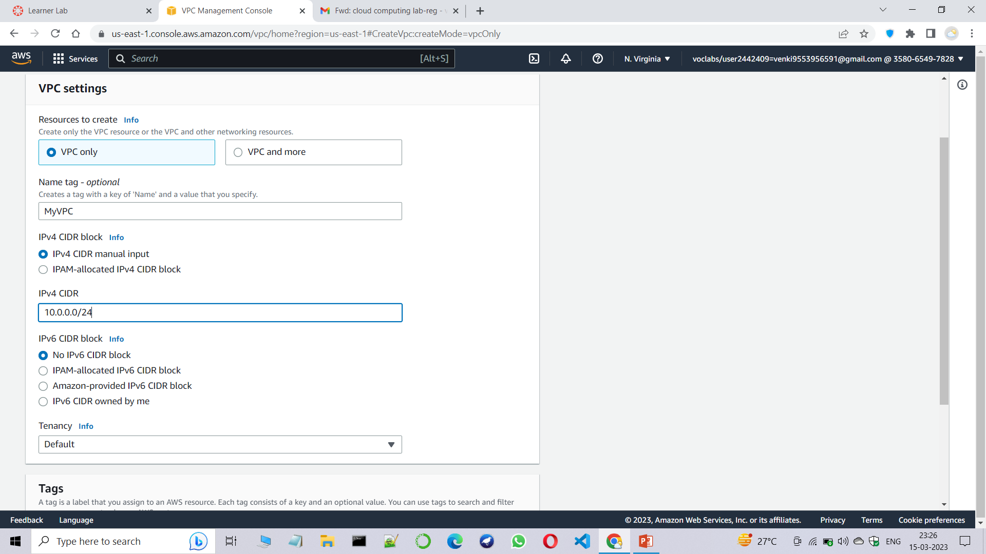
Step3:Enter the VPC name and IPv4 CIDR.

Slide 5
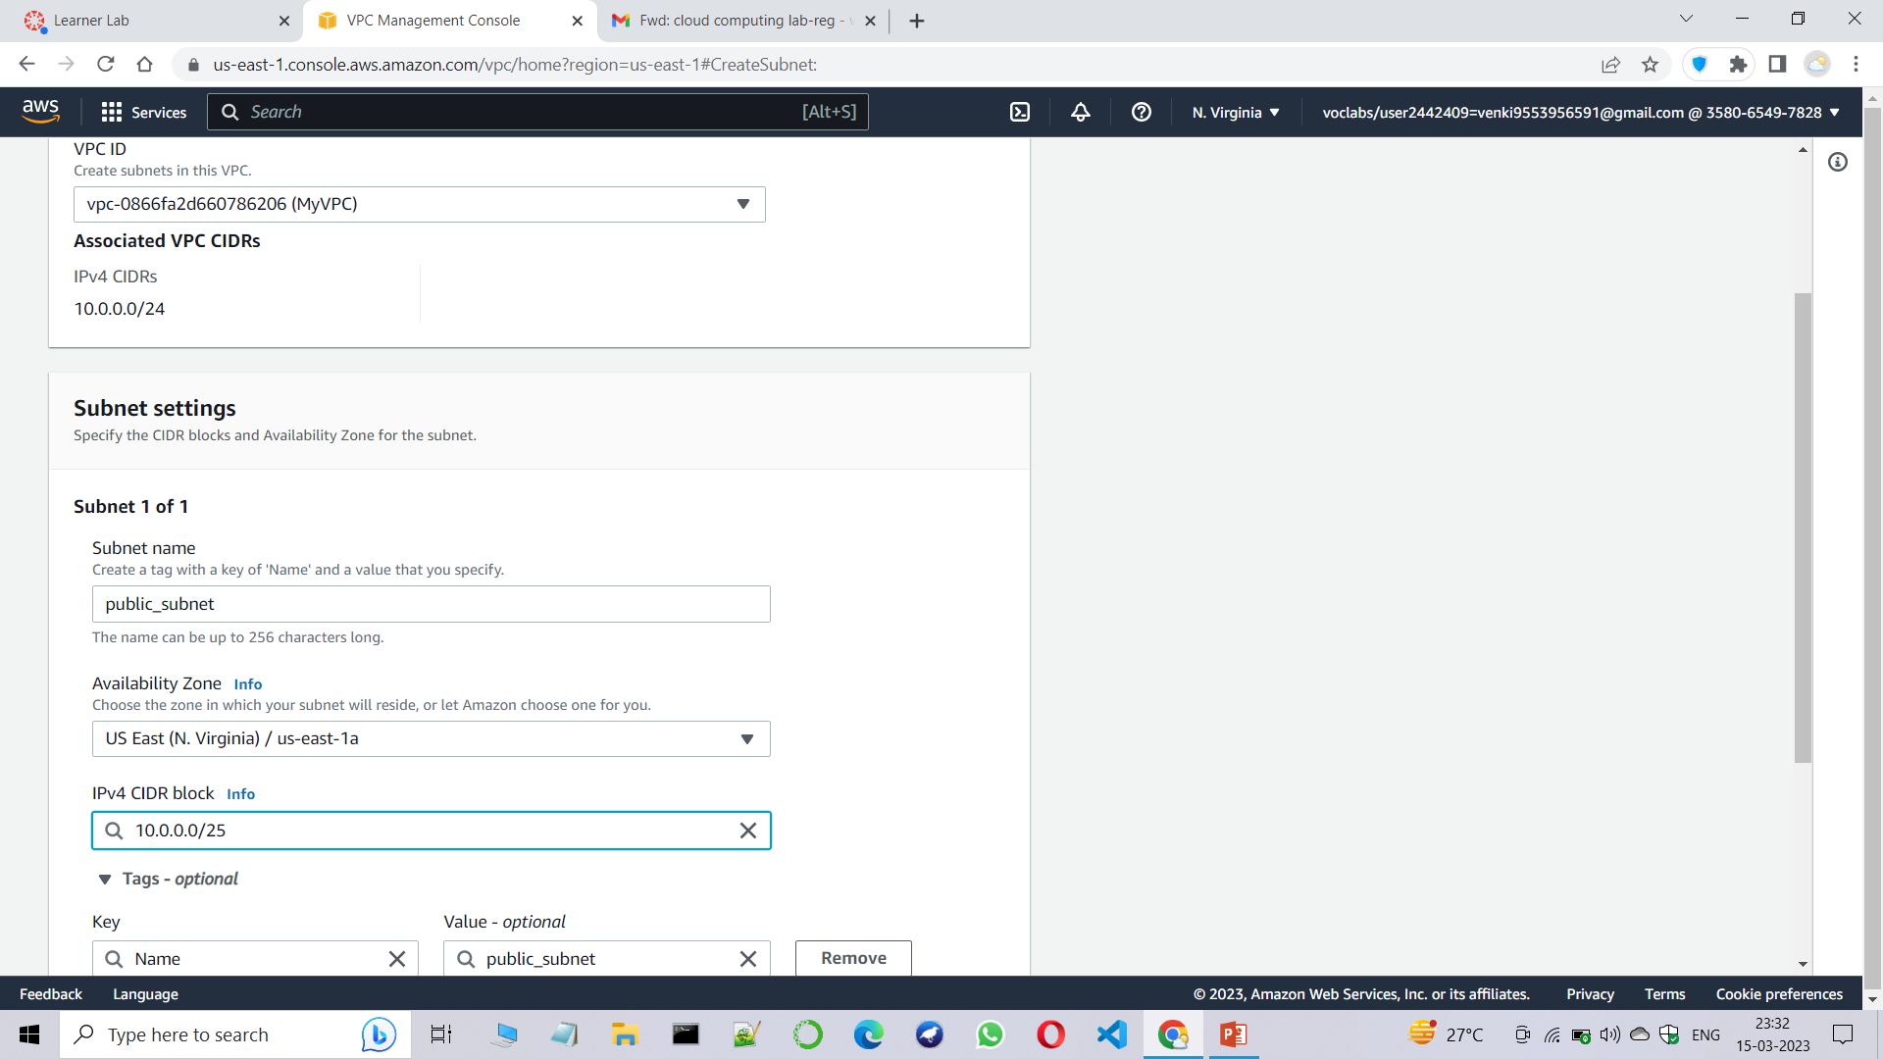
Step4:Now create public subnet and enter the subnet name and IPv4 CIDR as shown below.

Slide 6
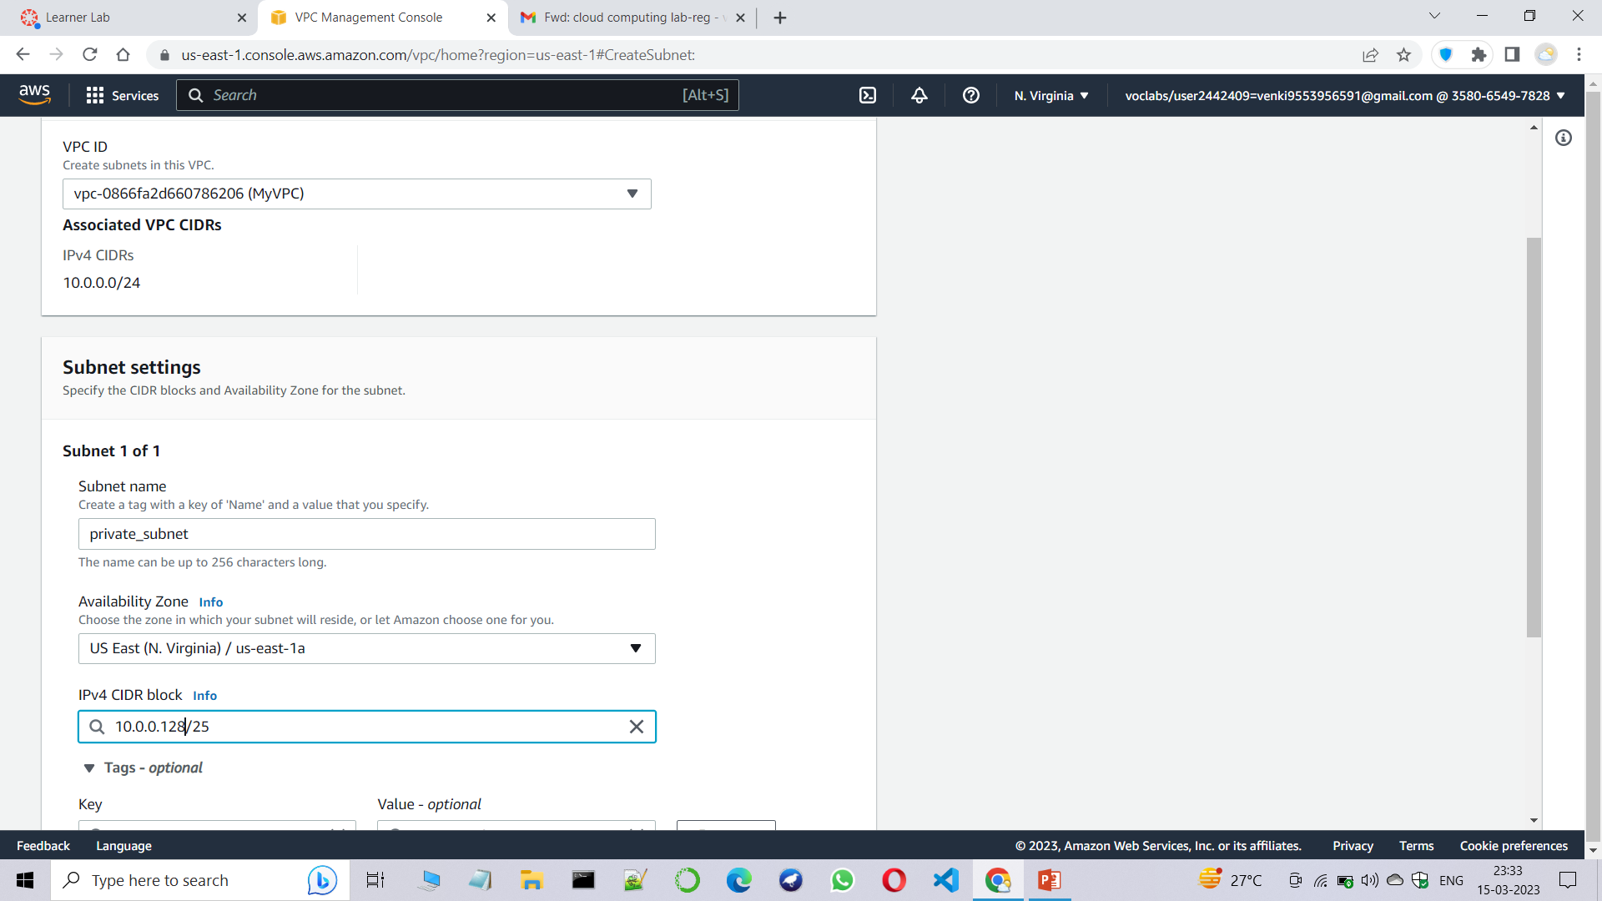
Step5:Now create private subnet and enter the subnet name and IPv4 CIDR as shown below.

Slide 7
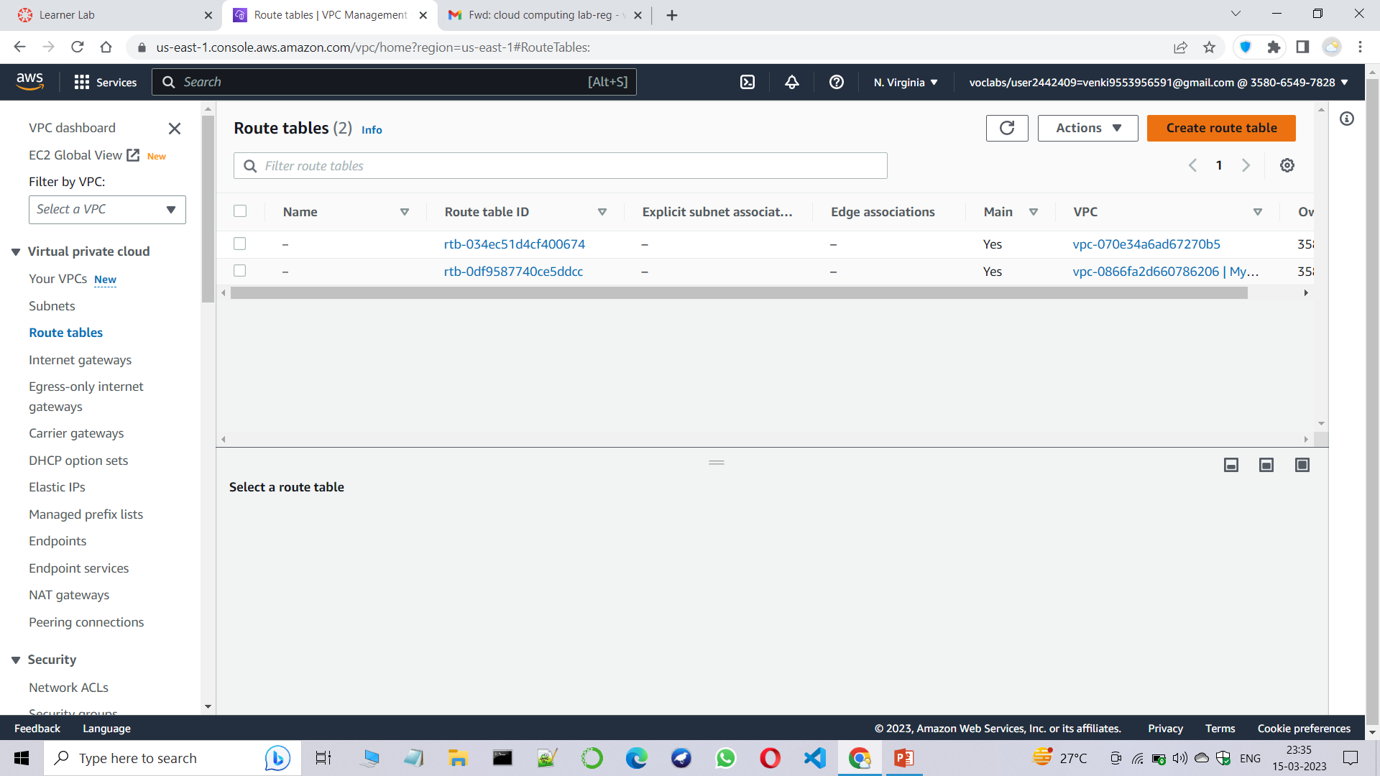
Step6:Now goto the Route tables and create route table.

Slide 8
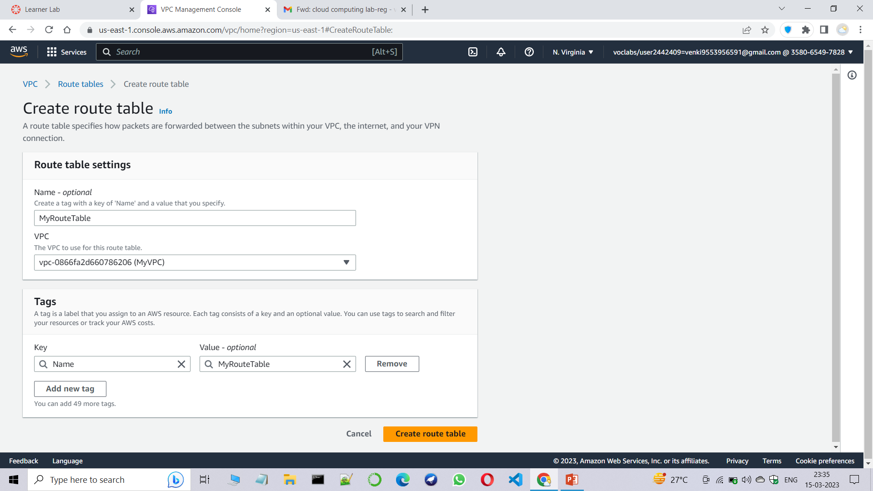
Step7:Create a route table as given below.

Slide 9
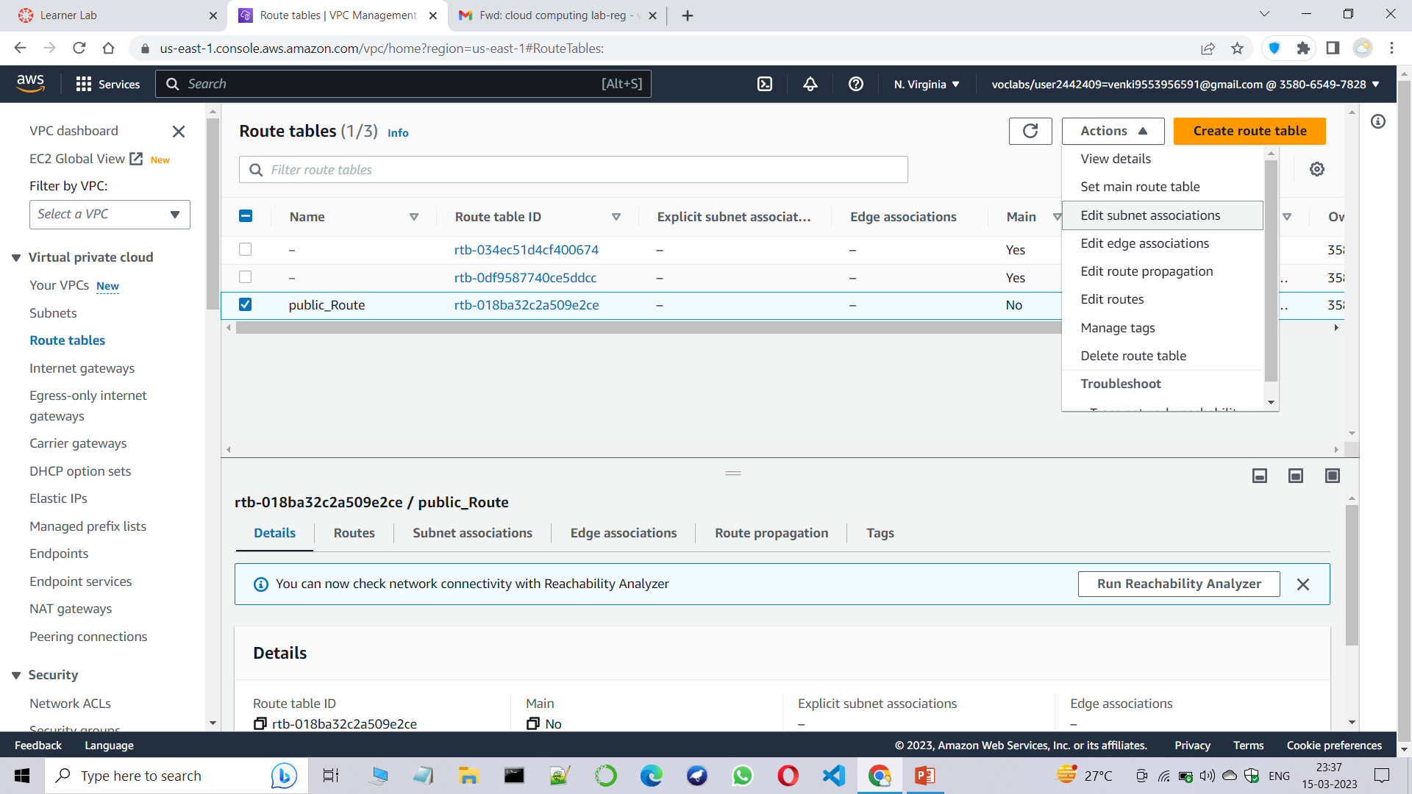
Step8:No goto the newly created route table and click on it and go to actions and edit subnet associations.

Slide 10
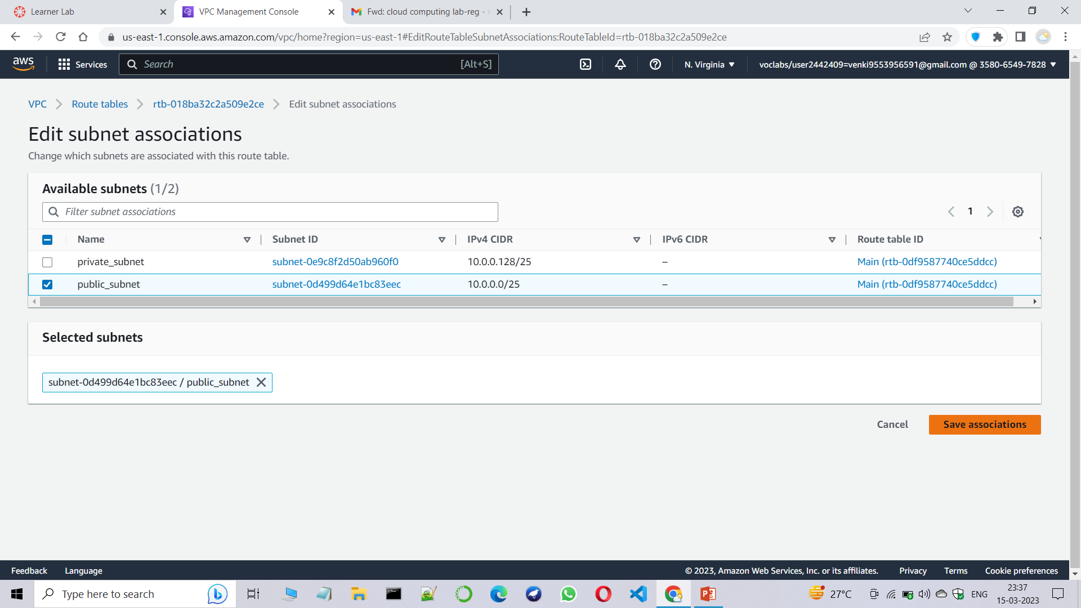
Step9:Now associate the public subnet with the public route table.

Slide 11

Step10:Similiarly create another route table.

Slide 12
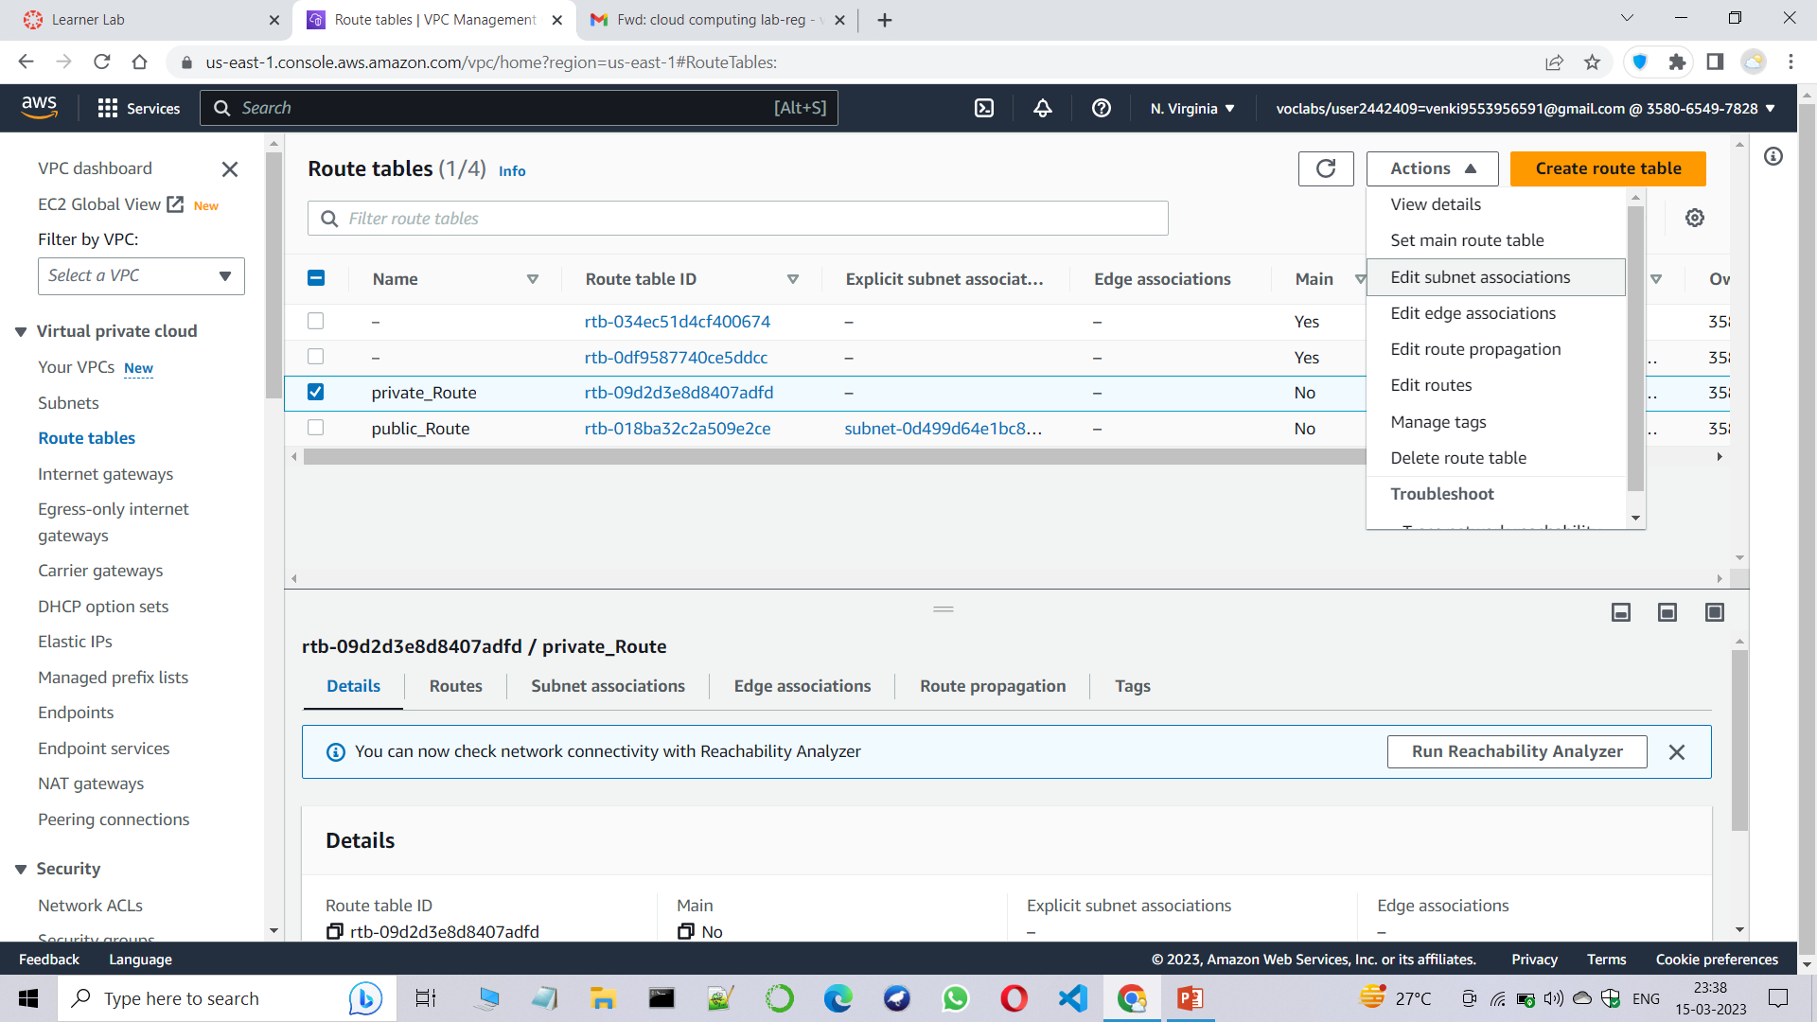
Step11:similiarly edit subnet associations for newly created route table.

Slide 13
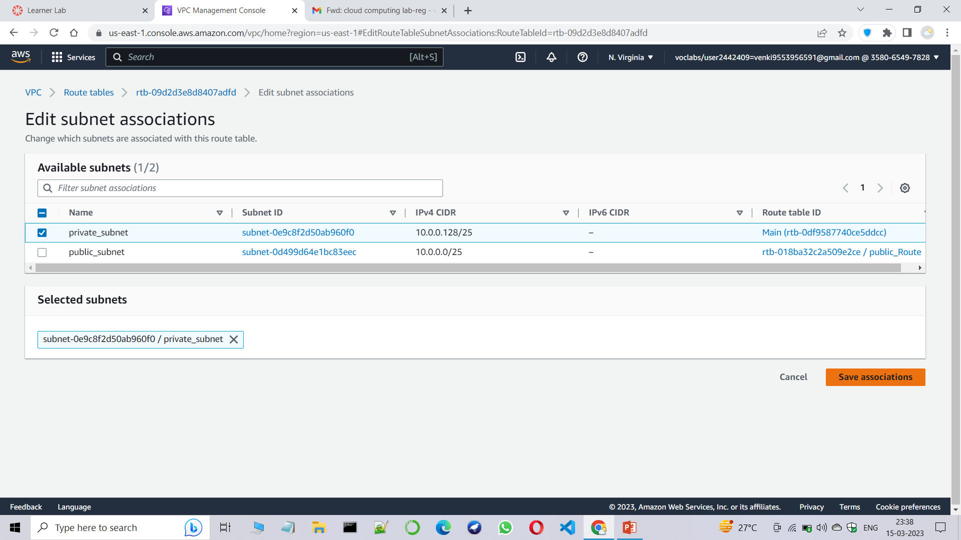
Step12:Associate the public subnet with public route table.

Slide 14
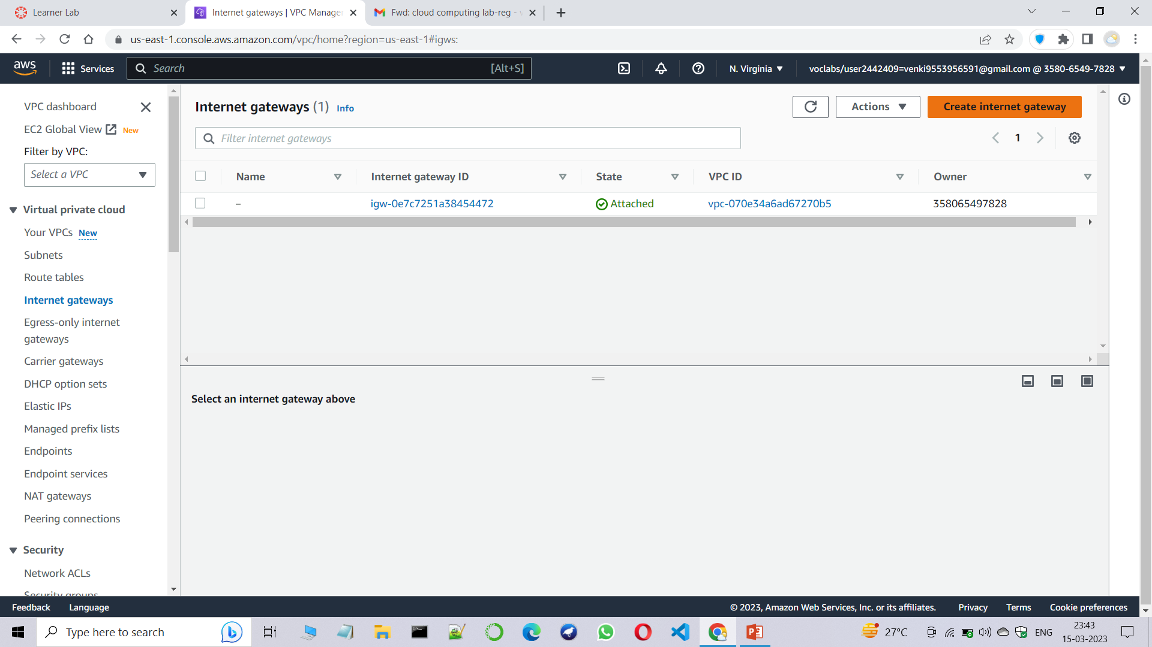
Step13:Goto the Internet Gateway .

Slide 15
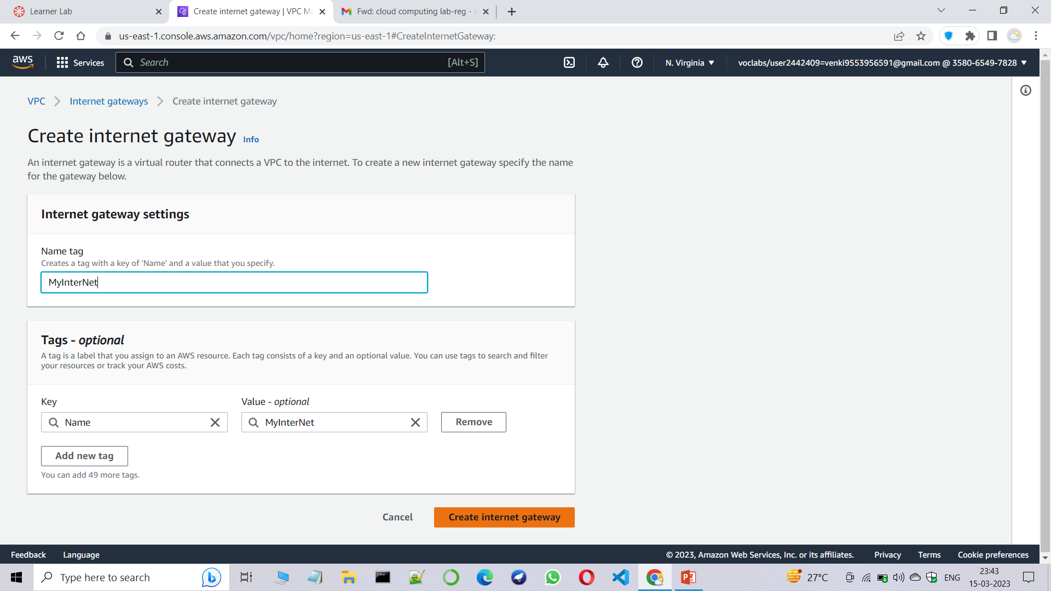
Step14:create an Internet Gateway.

Slide 16
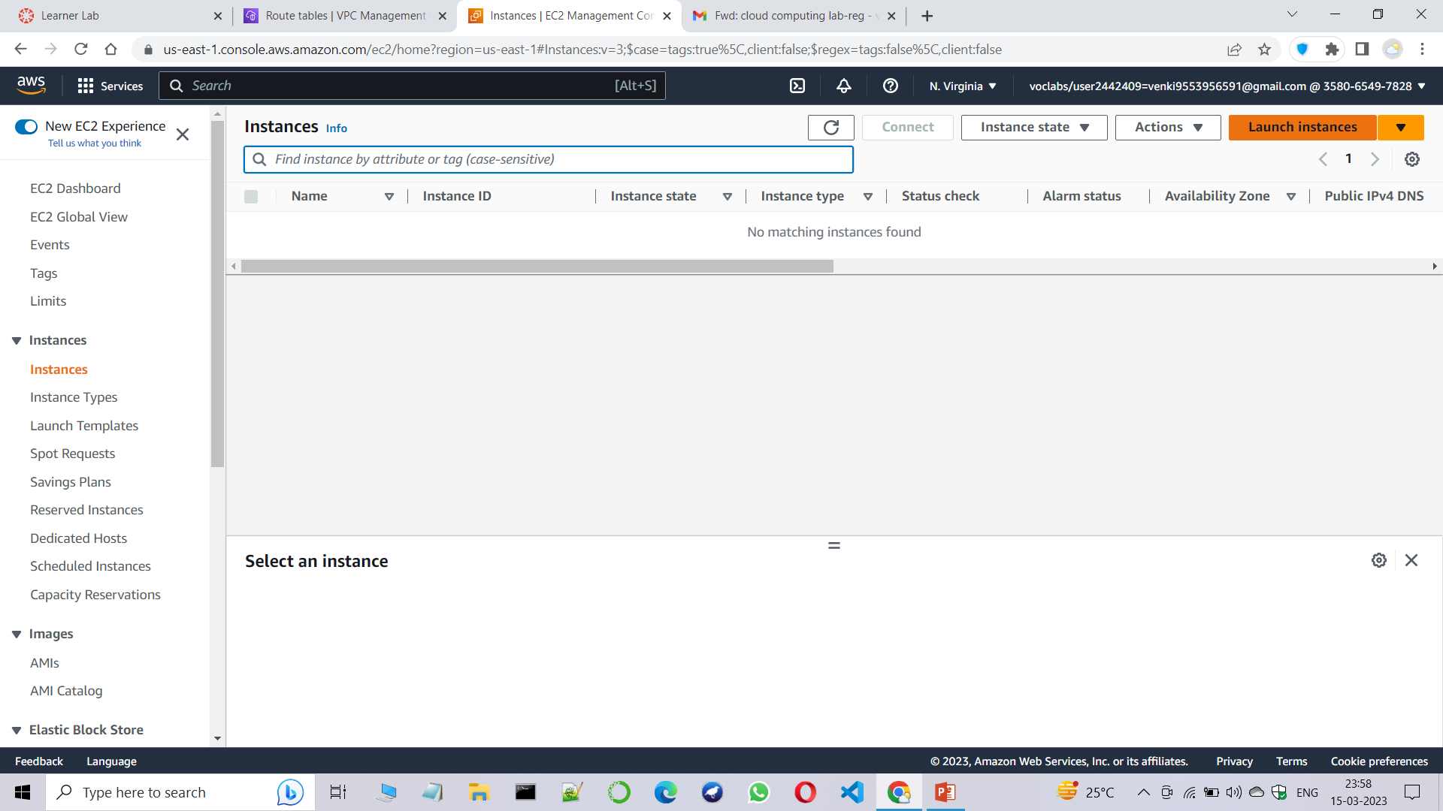
Step15:Now create Windows OS instances.

Slide 17
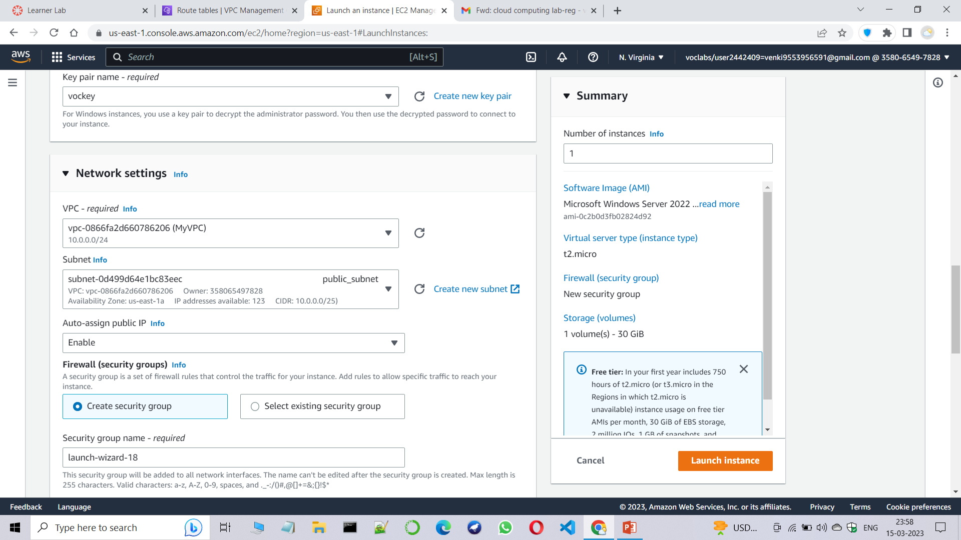
Step16:Edit Network settings and assign VPC and Subnets as shown below.

Slide 18
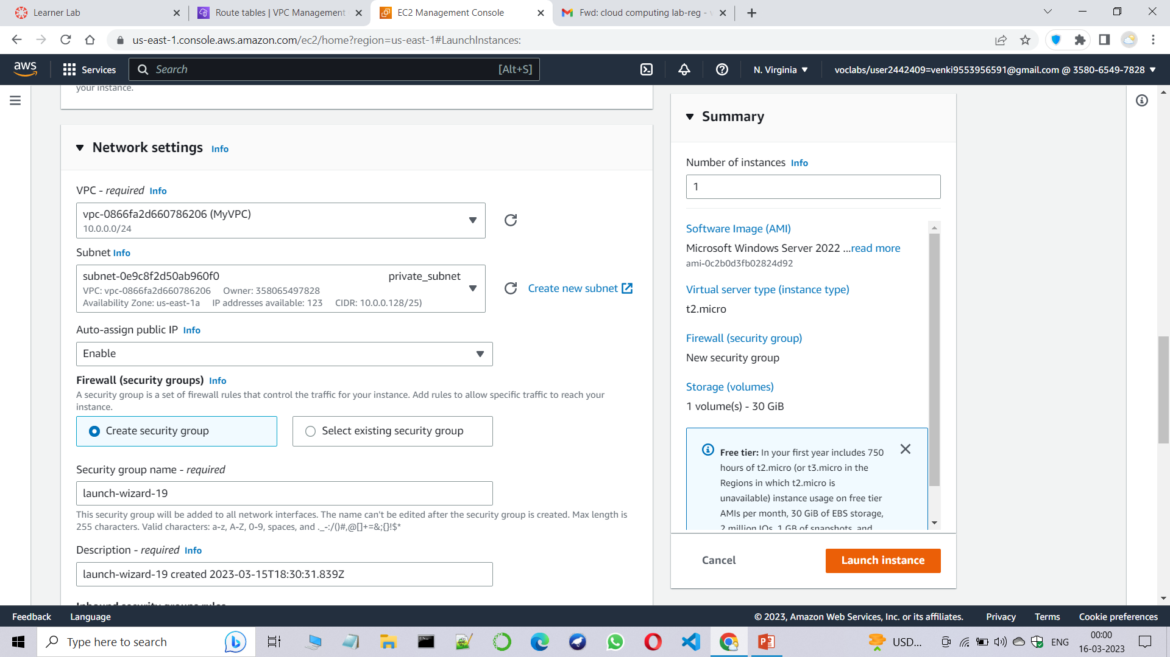
Step17:Edit Network settings and assign VPC and Subnets as shown below.

Slide 19
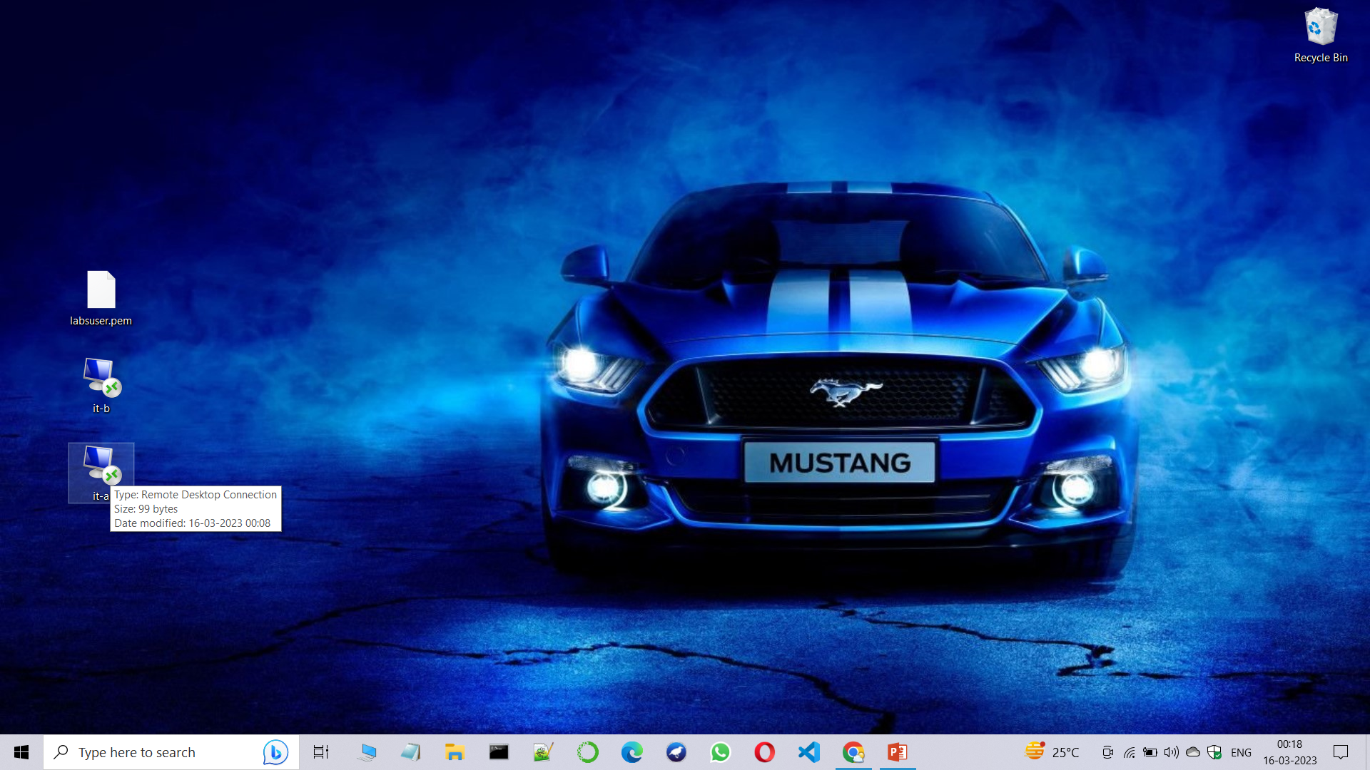
Step18:You can see two PC icons will appear , as they are the two instances.

Slide 20
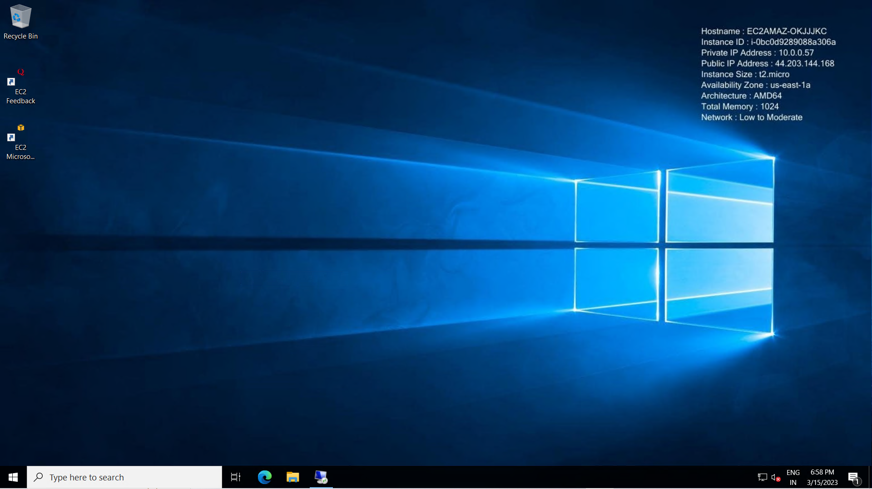
Step19:Click on the it-a icon and give respective password and login using RDP connection . You can see internet is connected to this RDP.

Slide 21
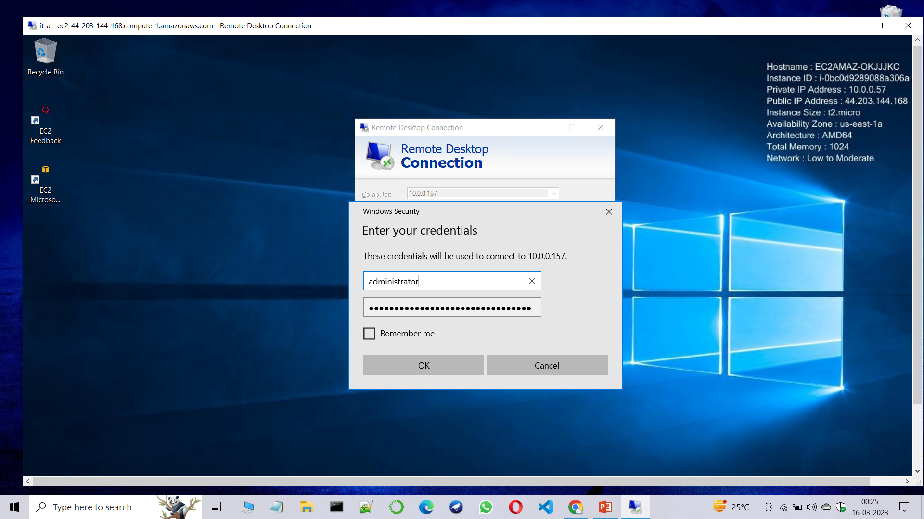
Step20:Search for Windows+r and type mstsc and give private instance private ip address and enter the details of it and login to it.

Slide 22
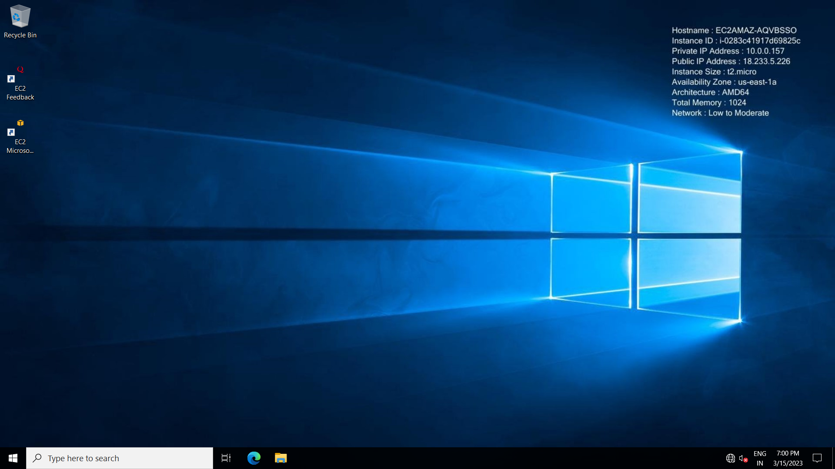
Step21:You can see that we are connected to the private instance but internet is not connected to this RDP.

Slide 23
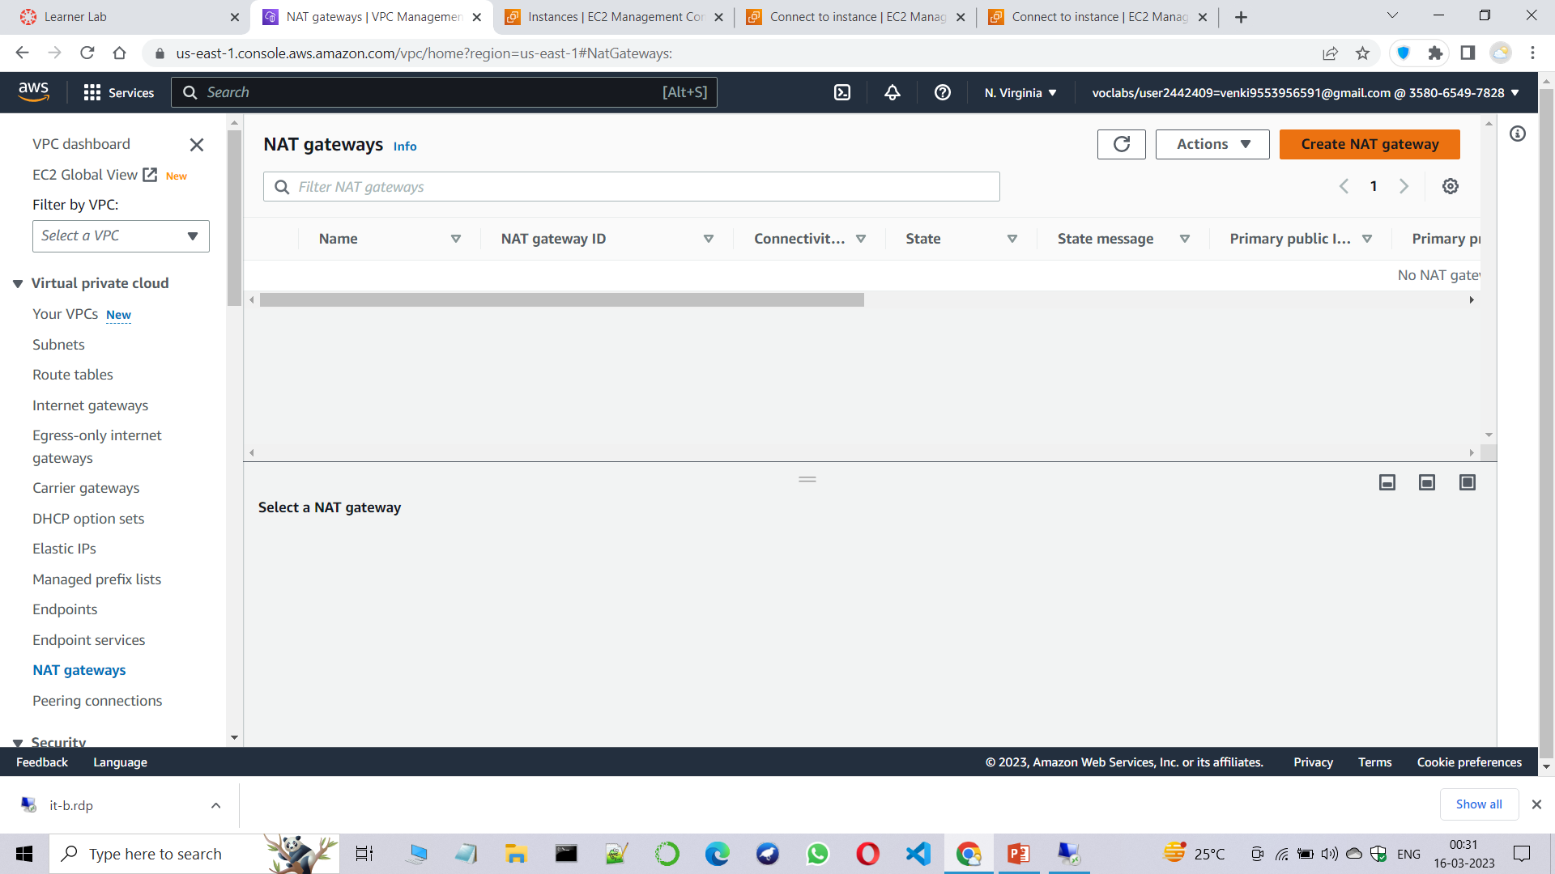
Step22:Inorder to rectify this problem , goto the NAT gateways and create a NAT gateway.

Slide 24
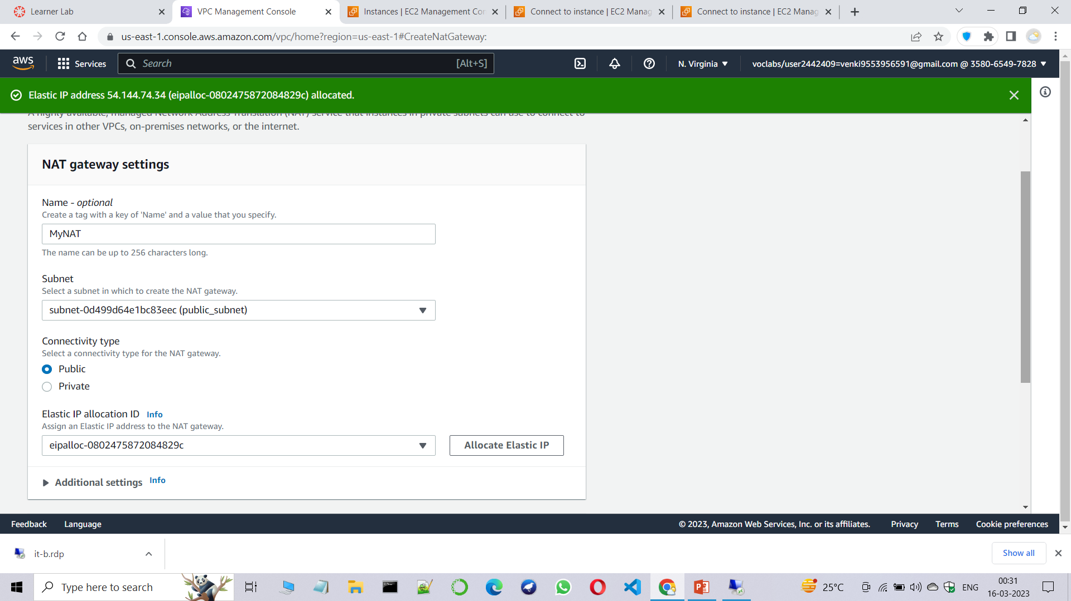
Step23:Give the details as shown below.

Slide 25
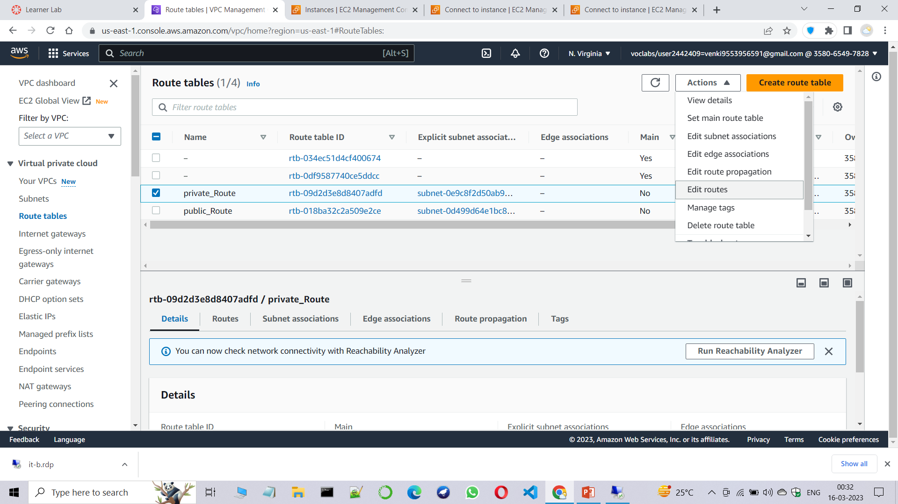
Step24:Goto the private route table and edit routes.

Slide 26
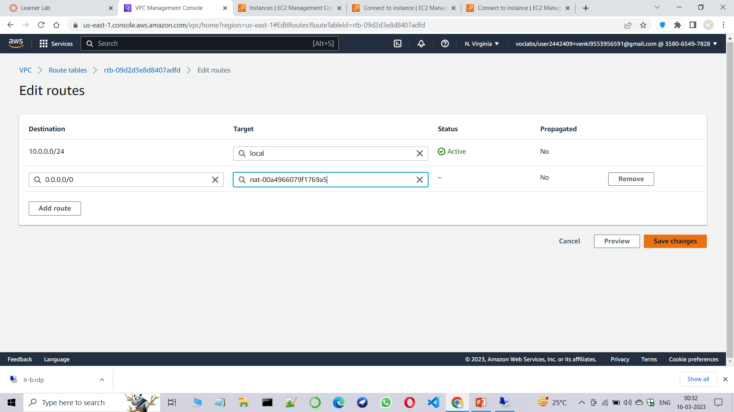
Step25:Add 0.0.0.0/0 route and save changes.

Slide 27
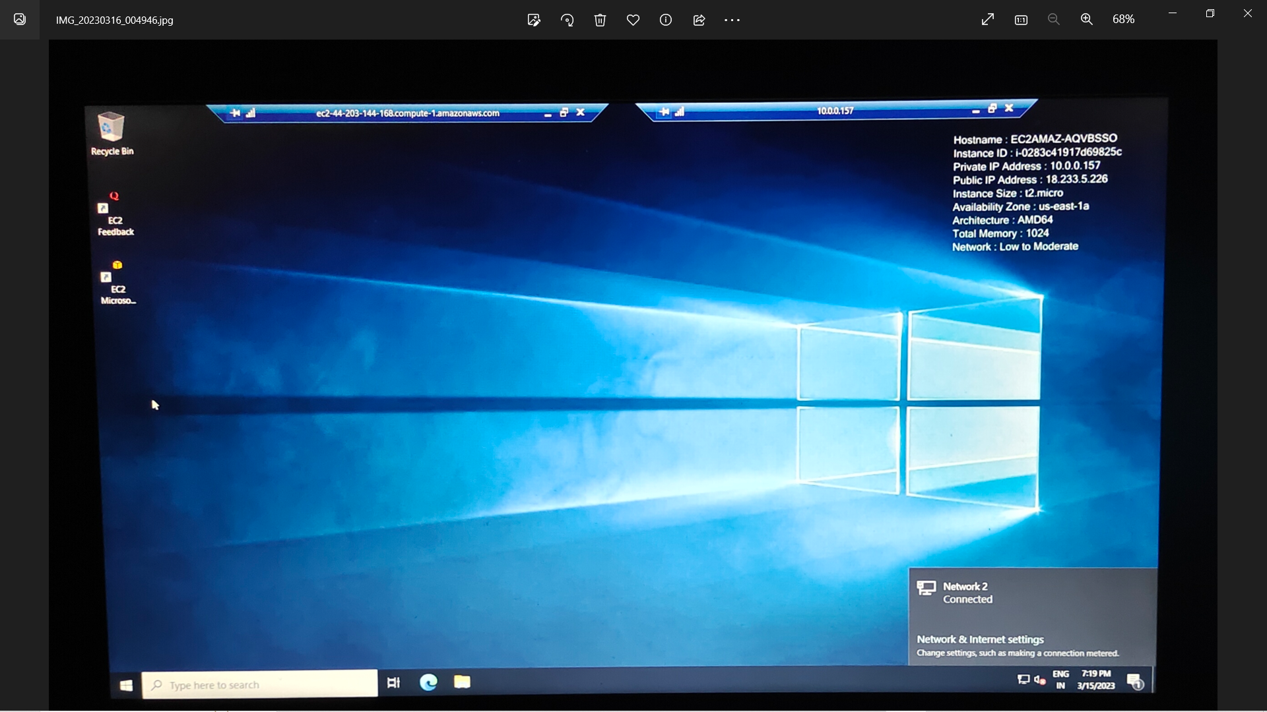
Step26:Now again login into the it-b instance and you will see the instance is connected to the internet.

